Slide 1

News You Need to Know from the Mailers Technical Advisory Committee
September 12, 2019
Presented by: Cathy Rupard, Dina Kessler, Neal Fedderman, and Glen Swyers

Slide 2




  This webinar is being recorded
  Please place phones on mute
  Please do not place us on hold; the audience hears the hold music
  Feel free to ask questions and add feedback when directed to do so by the presenter(s)
  Type your questions in the chat box
  A copy of the presentation will be posted on PostalPro under Education along with the recording
Notes:
Cathy
Before we get started, I would like to go over a few housekeeping reminders:
This webinar is being recorded
Please place your phones on mute
Please do not place us on hold; the audience hears the hold music
Feel free to ask questions and add feedback when directed to do so by the presenter(s)
Type your questions in the chat box
A copy of the presentation will be posted on PostalPro along with the recording
And now I will turn it over to Cathy Rupard.

Slide 3

MTAC – Overview
MTAC Overview
Welcome
PCC AC role
Session contributors
  Cathy Rupard
  Dina Kessler
  Neal Fedderman
  Glen Swyers
Notes:
Cathy R.

Slide 4

What is MTAC?
The Postmaster General’s Mailers’ Technical Advisory Committee (MTAC) is a venue for the United States Postal Service (“Postal Service”) to share technical information with mailers, and to receive their advice and recommendations on matters concerning mail-related products and services, in order to enhance customer value and expand the use of these products and services for the mutual benefit of Mailing Industry stakeholders and the Postal Service.
Mailing Address:
  MTAC Program Manager
  Marketing
  US Postal Service 475 L’Enfant Plz SW
  Washington DC 20260-4411
Email Address: MTAC@USPS.GOV
Web Site: postalpro.usps.com/mtac

Slide 5
MTAC Open Session

Slide 6
MTAC Open Session
Held Tuesday before MTAC meetings
Everyone can attend
August 27, 2019 Agenda
Notes:
MTAC Open Session
Held Tuesday before MTAC meetings
Everyone can attend
Typical Agenda
The August meeting the Open Session was changed to give more depth and information to the speaker’s reports. This change resulted in more “meat” during Open Session.

Slide 7
MTAC – Open Session
August 27, 2019 Open Session Highlights
Postmaster General
  PMG shared the USPS Leadership Team supports Administration and are prepared to withdraw from Universal Postal Union if they needed. This is not a postal driven decision.
  PMG stated a strong need for changes in the USPS fiscally if they are to survive past the next decade
  Board of Governor’s have a full quorum. Their first board meeting and discussion points will be on the 10-year plan as well as how to address the $125B shortfall. Meetings will take place on October 2 and 3, 2019.

Slide 8
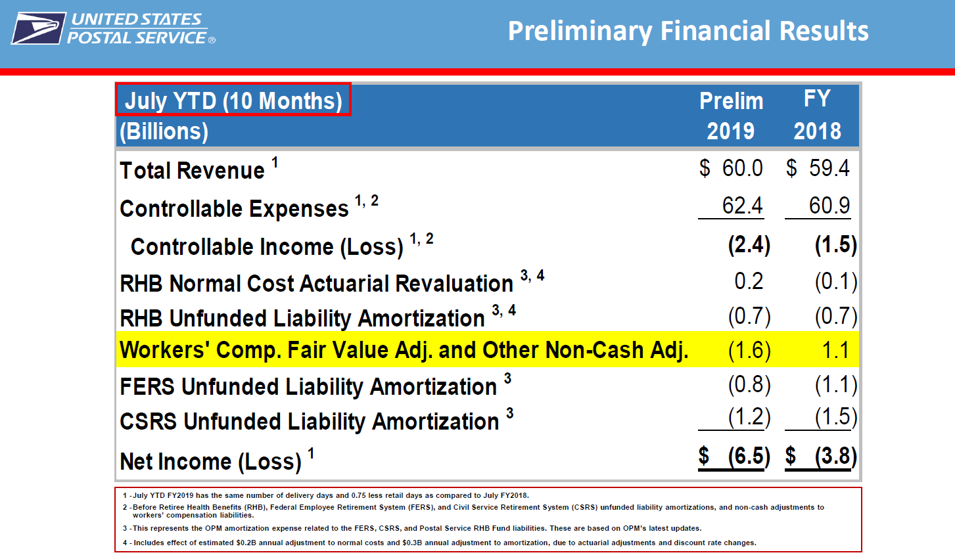
MTAC – Open Session

Slide 9
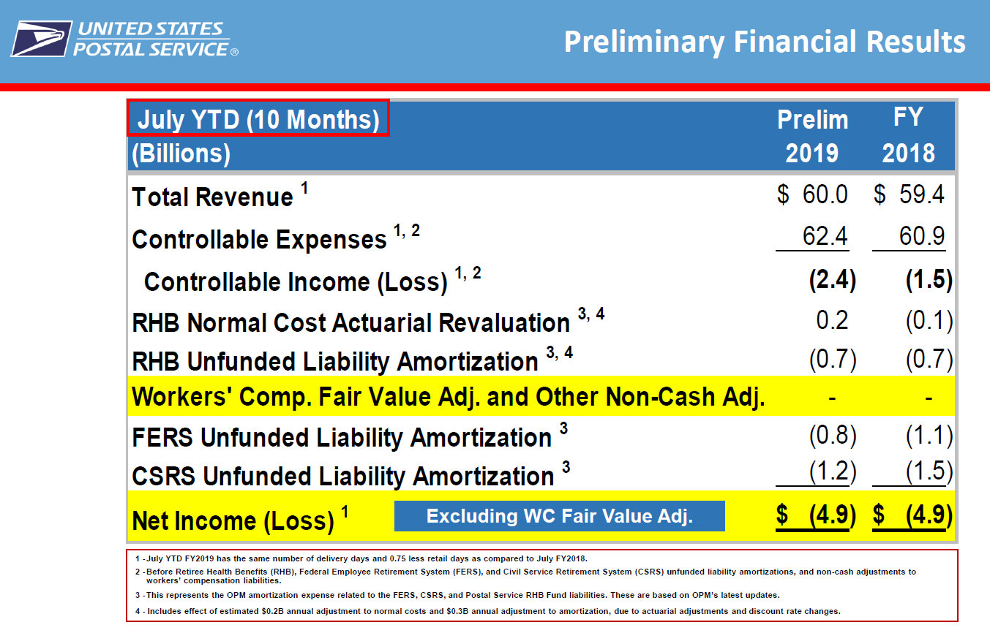
MTAC – Open Session

Slide 10
MTAC Open Session
Marketing Update
Jakki Krage Strako
Chief Customer and Marketing Officer and Executive Vice President
Notes:
Neal

Slide 11



Highlights:
Nearly 100 PCC events nationwide, nearly 140 PCCs participating
PMG Thank you and Welcome Video to USPS Business Partners
Headquarters Officers and Executives speaking at PCCs coast to coast:
  Theme – Growth Driven: Fueling Your Mailing and Shipping Success
  Mail Moment Research
  The Customer Journey
  New Mail Innovations
  Package Business

Slide 12
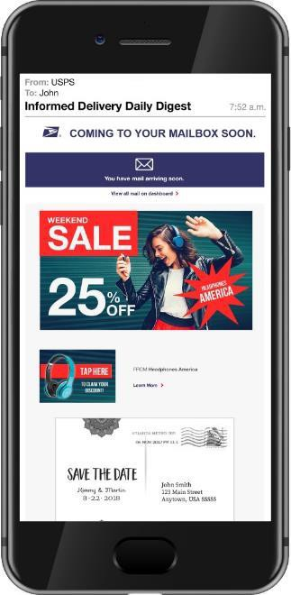
INFORMED DELIVERY – BY THE NUMBERS
18.62M
Registered Users
18,230
Campaigns Created
13.6M
Email-enabled Users
2,478
Brands Represented
208K+
Weekly User Registrations
62.87%
Average Email Open Rate
Registered users and email-enabled users as of week of August 20, 2019. Daily user registrations as of August 20, 2019 (8-week average). Campaigns completed and brands represented as of August 20, 2019. Average email open rate from December 2018 through May 2019.

Slide 13
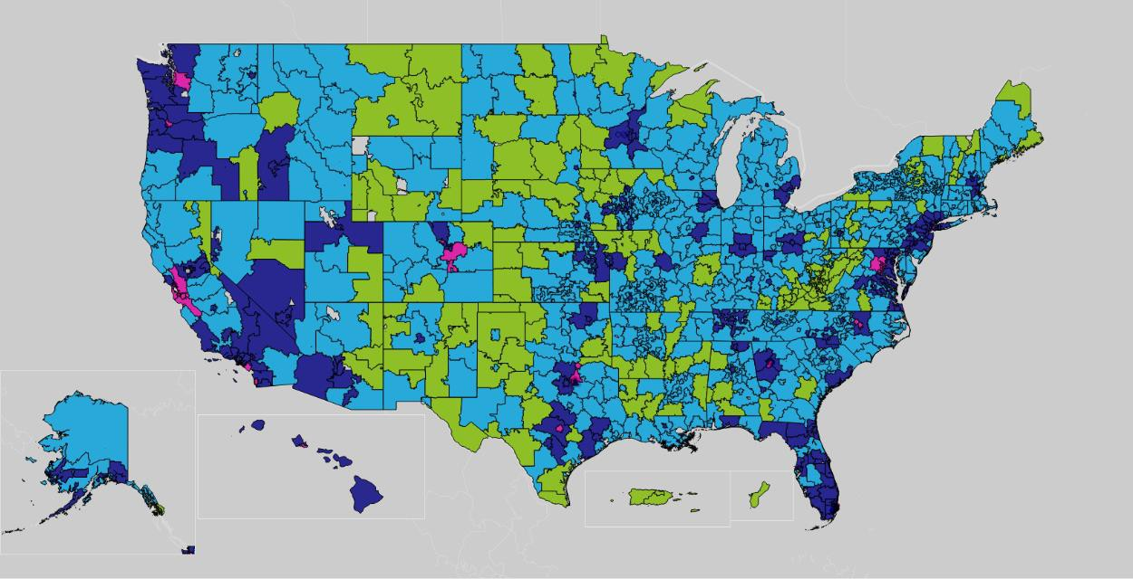
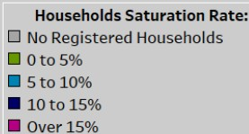
MAIL AS PART OF THE DAILY DIGITAL ROUTINE
Informed Delivery® maintains the relevance of mail in an increasingly digital society.
Household Density Saturation
11.8% National Saturation of Eligible Deliveries

Slide 14
WHY MAIL POSITIONING
Direct Mail
Digital
25,000
180
160
140
120
100
80
60
40
20
-
20,000
15,000
10,000
5,000
-
2007 2009 2011 2013 2015 2017 2019 2021 2023
Revenue Linear (Revenue)
Revenue
Linear (Revenue)
Notes:
Is this where Dina takes over?

Slide 15
























Background
WE TESTED CONCEPTS WITH MARKETERS
TAPPED INTO EXPERT INSIGHTS
DIVERSE BRANDS
DIVERSE ROLES
Head of Digital Customer Experience
Head of Growth Marketing
Head of Digital Marketing Media Communications Planner Chief Product Officer
VP, Ecommerce
VP Integrated & International Programs VP, Loyalty, CRM, & Multicultural Marketing
Director, Consumer Insights & Analytics Addressable Digital Advertising Manager
Sr. Director, Marketing Management & Sales Enablement

Slide 16
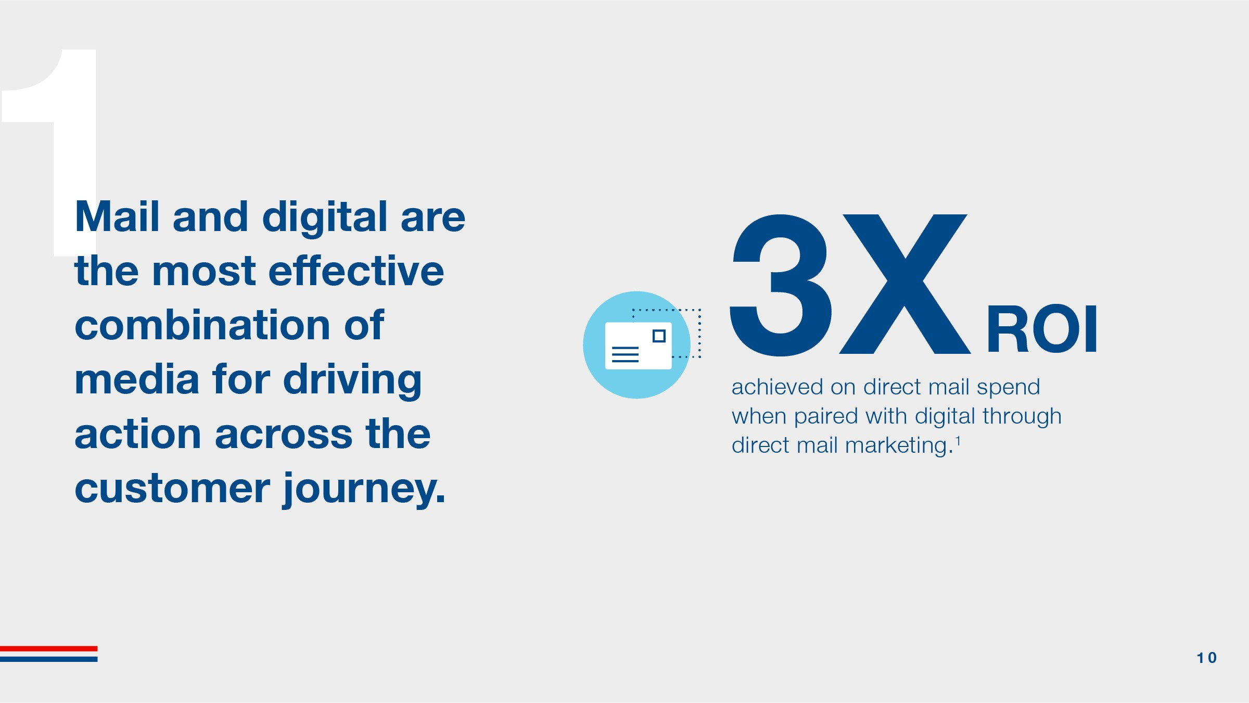
Mail and digital are the most effective combination of media for driving action across the customer journey.

Slide 17
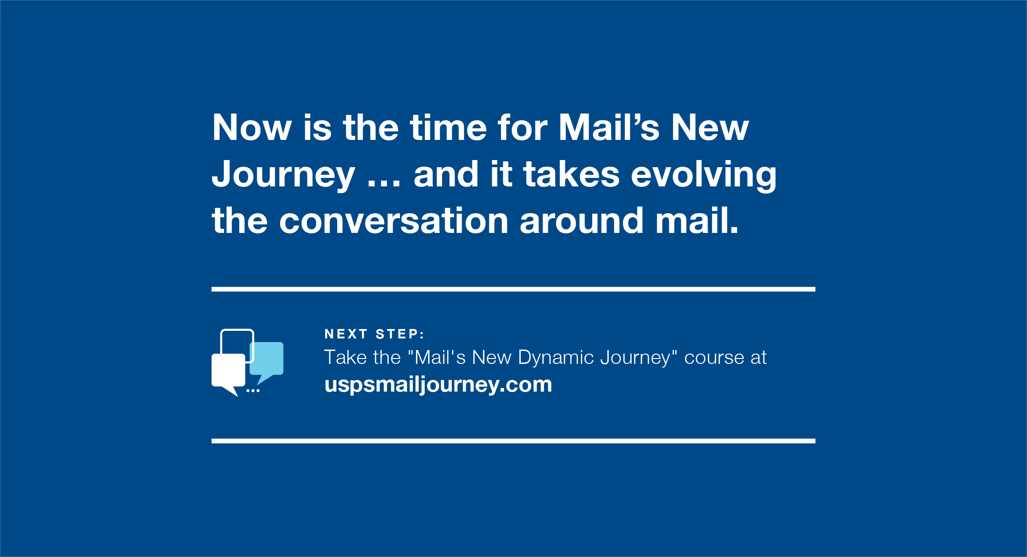

Slide 18
Mail Moments Spring 2019

Slide 19
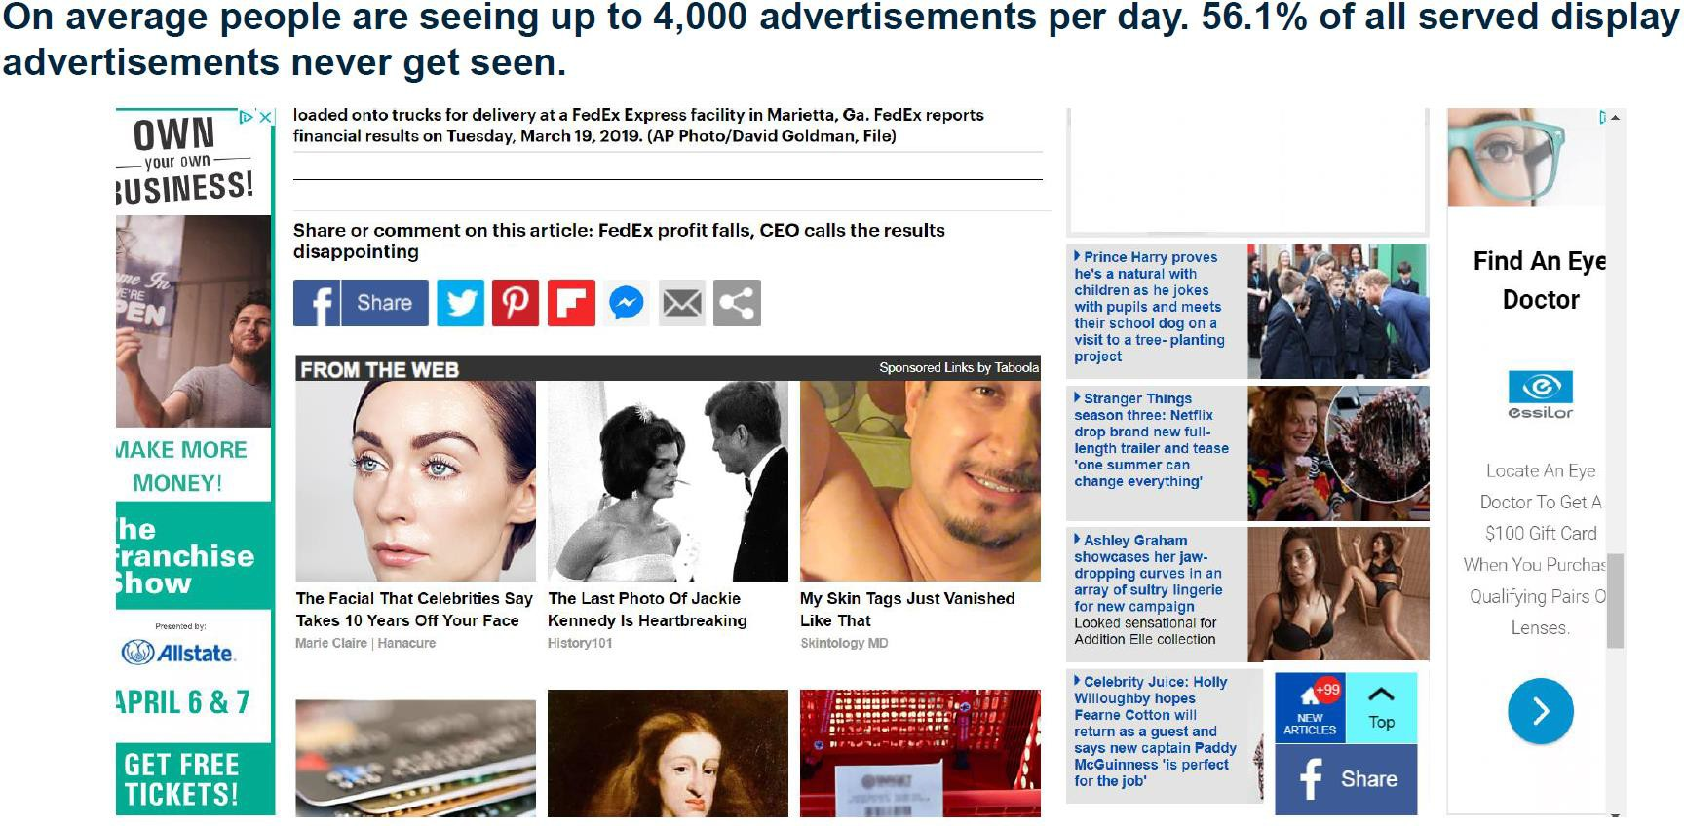

Slide 20
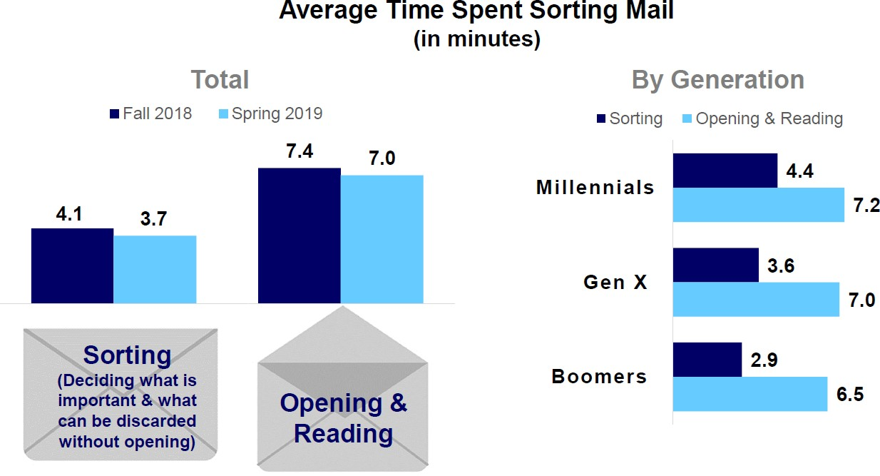
Millennials spend the most time both sorting and opening/reading their mail

Slide 21
Key Takeaways
77% of consumers check their mail 5 days a week
93% are checking for something important
59% read their advertising mail before discarding
Consumers spend on average 10 minutes ‘sorting, opening, reading their’ mail
Magazines, Coupon Booklets, & Ads from local stores are most engaging
56% of consumers have tried a new business after receiving a direct mail piece
ID has reached 11.8% national saturation & 62% email open rate
72% of respondents indicated clicking on an ID Interactive Ad, 68% made a purchase

Slide 22


Informed Delivery® Promotion Summary
®
2% Discount
on Eligible Postage
Promotion Registration
July 15 – November 30
Promotion Period
September 1 – November 30
Notes:
Glen starts here?

Slide 23



Informed Delivery Growth
Substantial growth within Informed Delivery is expected for both mailer campaigns and participating consumers
Campaign Creation
Projected Daily Campaign Pieces during Promotion (9/1 – 11/30)
Participating Consumers
300
275
September 2019
Year End 2020
250
Millions of Pieces
200
19 Million
20 Million
40 Million
150
Year End 2019
100
50
0.5
55
0
Today
16%
Participation
100%
Participation

Slide 24
Informed Delivery Enhancements – Overview
USPS has made changes to ensure Informed Delivery can scale to support business growth and the September 1st promotion. Enhancements include:
1
Increased speed of email processing; improved portal load times
2
Streamlined Campaign information transmission between PostalOne! and ID
3
Improved Informed Delivery Campaign report performance
4
Active monitoring of metrics across all Informed Delivery systems

Slide 25

Mailer Campaigns – PostalOne!
UPDATE : New PostalOne! eDoc warning messages to prevent common campaign set-up errors
To avoid set-up errors | Warning Messages
Ensure start dates are not in the past when submitting Ready to Pay | For an Informed Delivery Campaign, the .rms Date Start or the .csm Referenceable Mail Start Date cannot be in the past
Ensure start dates are not today when submitting Ready to Pay | For an Informed Delivery Campaign, the .rms Date Start or the .csm Referenceable Mail Start Date cannot be the same date as the eDoc submission date.
Verify URLs are correct when submitting Ready to Pay | For an Informed Delivery Campaign, the .rmr RMR Value must be formatted properly (http://www.url.com)

Slide 26



Mailer Campaigns – PostalOne!
®
Approved campaigns are sent to PostalOne!® at 2pm daily to be claimed for the incentive on a postage statement
Campaigns created in Mailer Campaign Portal must be submitted by 1:30pm Eastern the day prior to submission
Why: For inclusion in the daily transmission to Program Registration.
Campaigns created with a Mail.dat RMB should be uploaded to PostalOne!® by 12:00pm
Why: For inclusion in the 2pm transmission to Program Registration.
Campaigns created with a Mail.dat RMR or Mail.XML do not have to be approved by ID before the incentive is applied to the postage statement.
Why: Promotion immediately applied to postage statement
1
Setup Campaign in Mailer Campaign Portal
Create Campaign with Mail.dat RMB
PostalOne!
@2pm
Program Registration
PostalOne!
2
Mailer Submitted
Informed Delivery
Approved
Approved
Campaigns
Campaigns
Campaigns
3
Create Campaign with Mail.dat RMR or Mail.XML
Promotion immediately applied to postage statement
Under 1 Minute
Up to 15
To Tr
minutes
ansfer
Under 1 Minute
To Transfer
To Transfer
USPSInformedDeliveryCampaigns@usps.gov or call 1-877-329-7206
Mailer Server with Images
Future Design: Campaigns will be submitted to PostalOne!® in real time instead of on a job schedule

Slide 27
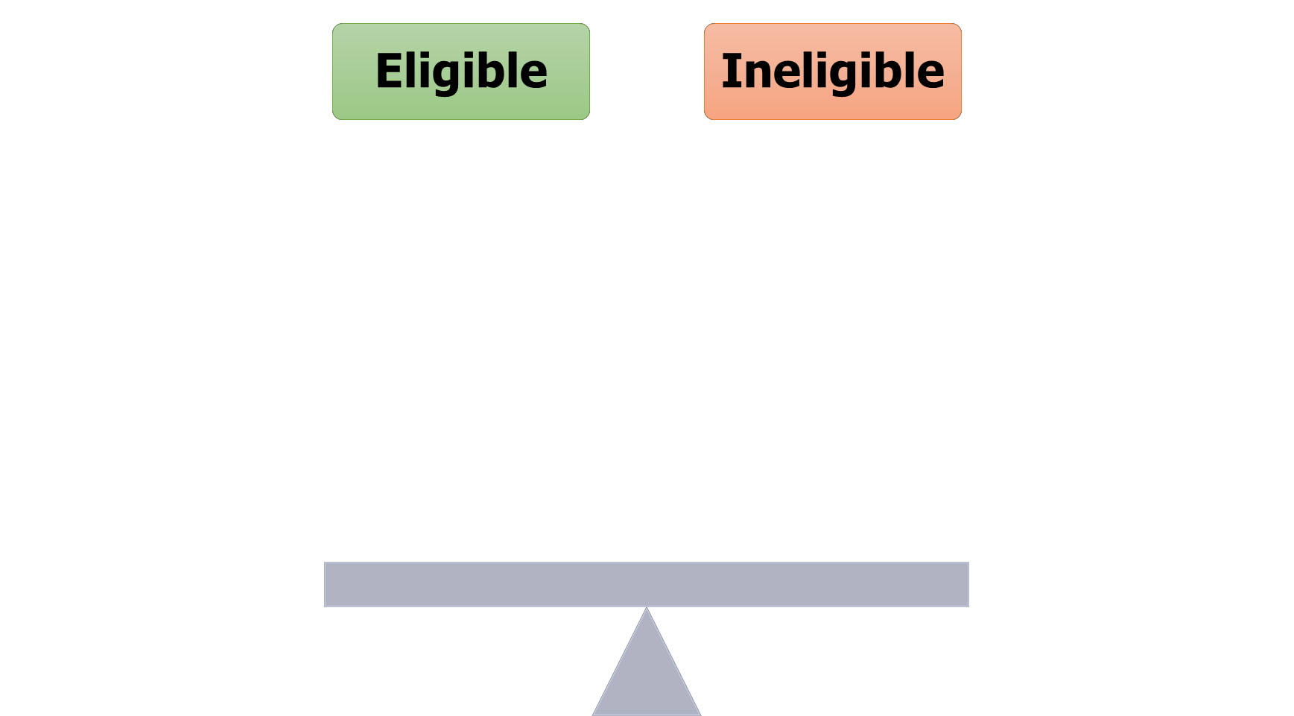



























®

Slide 28
USPS Leadership Forum for Stakeholders
Joshua D Colin PhD
A/Vice President Mail Processing and Maintenance August 27, 2019
Notes:
Cathy R.

Slide 29

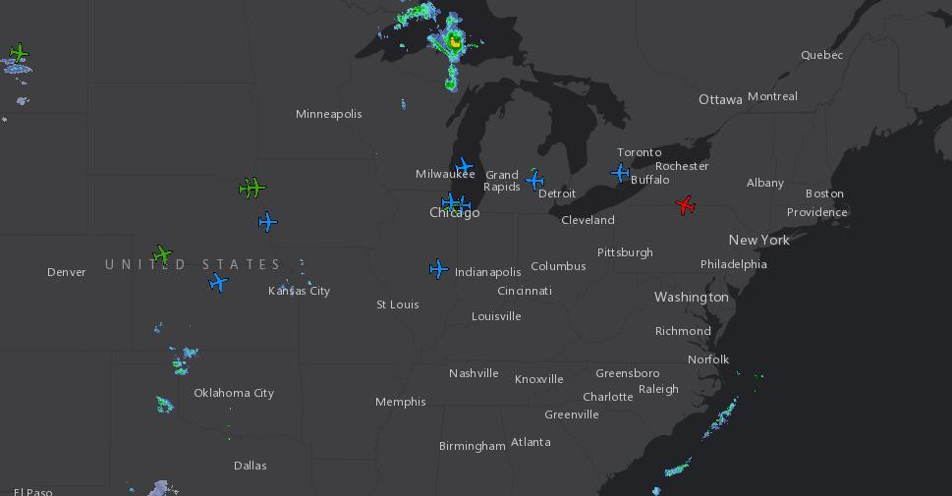
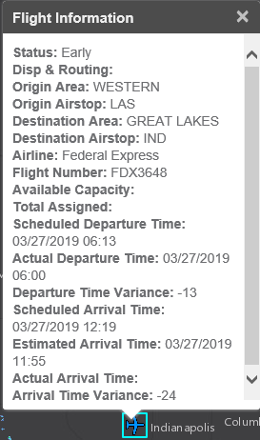
Flight Logistics & Performance System (FLAPS)
Allows the user to filter by destination and scheduled arrival time in order to plan for incoming inventory

Slide 30
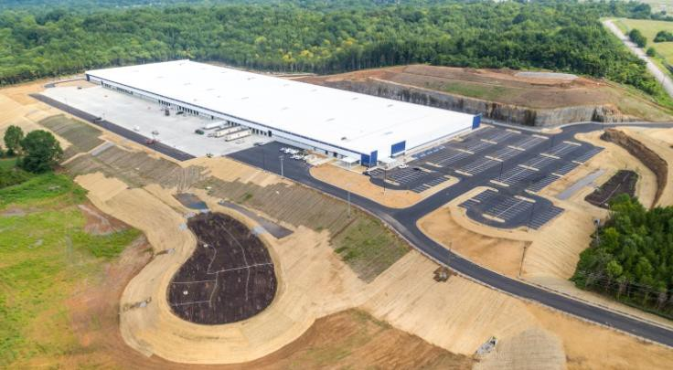
Music City Annex (MCA), NASS 372MA
New Facility – Nashville
Newly constructed facility ≈450K sq. ft.
Process bundles, flats, and parcels
Package and Flat Processing
Automated Guided Vehicles (AGV)
Mail Direction File (MDF) to be effective October 1 for all flats and parcels, DADC (307, 370-374, 384-385, 421-422) and DSCF (370-372, 384-385, 421-422)

Slide 31
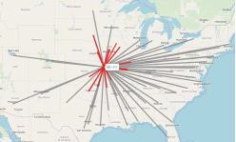
Surface Transfer Center Redesign
Kansas City STC Plan
17 origins/destinations within 8 hour drive time to be serviced
78 inbound/outbound scheduled trips
Deployment planned for September 16, 2019

Slide 32





Slide 33




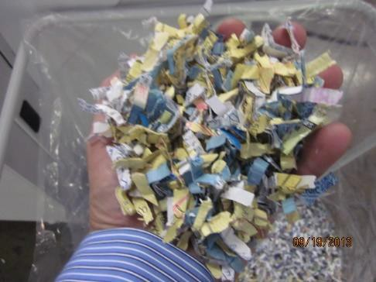
SD Mail Service Expansion to Flats
USPS Secure Destruction for flats uses a more robust and powerful industrial cross-cut shredder.
Paper shred size is still at DIN 66399 P-Level 4: Particularly Sensitive
& Confidential Data ( Surface Area less than 60mm²⁾
HSM Model 400.2
for Letter Mail
HSM Model 500.3
for Flat Mail

Slide 34



Mailer Update
Mailer Statistics – July 2019
125 major mailers enrolled
Mailers registered under 164 primary accounts and 192 MIDs (+5) and 10 STIDs
15 mailers using multiple primary accounts

Slide 35
MTAC
Focus Group
Sessions

Slide 36
MTAC Focus Group
Held on Wednesday
  Mail Prep & Entry
  Enterprise Analytics
  Payment & Acceptance
  Product Innovation
Break out by classes
Rotating briefings
Notes:
MTAC Open Session
Held Tuesday before MTAC meetings
Everyone can attend
Typical Agenda

Slide 37
Mail Prep and Entry, Operations

Slide 38
Mail Prep and Entry – Operations
Joshua Colin PhD
  Why Flats containers are scanned better than letters?
  Looking into it.- but most likely all the residual letter skids of 1 tray
  FAST Appointment still an issue
    28% No Show
    Some facilities are at 40% no show
    Working on UG 3
    One issue only 1 change per appointment
  Provided a Slide of all the OFFICAL UAA for Carriers
Presentations available on PostalPro!
Notes:
When postal publications are updated send messaging via Industry Alerts
Create How to File a Dispute protocol
Ask for take aways from First Class, Marketing Mail

Slide 39
Enterprise Analytics

Slide 40
Enterprise Analytics
Enterprise Analytics
  Steve Dearing
    Predictive Delivery
    Pilot GPS on Transportation Trucks
    Levering app on truck drivers Smart Phone to generate bread crumbs
    The key is 85% Visibility for Marketing Flats
    A couple of years ago was in the 40% range
    This week USPS is rolling out the Manual Operations to capture offline Bull Pens
    Beginning Q1 - the data will be provisioned to map into the main data stream
    This is using SV Scanners
    Scary… the drop in Mail Volume

Slide 41
Enterprise Analytics
Jim Wilson
Trying to update policy - old days took 2 months to make a change can take 9 days… but it is still under the old policy
  COA
  Label List Updates
Just caught the policy record that wasn’t update… now won’t send an invoice for under $25
Why get Marketing Mail back…False returns
  Customer market it up
  If the PARS can’t tell the postage - always assume FCM
Increase Security on COA request
Notes:
Dina give examples

Slide 42
Product Innovation
Emerging Tech

Slide 43
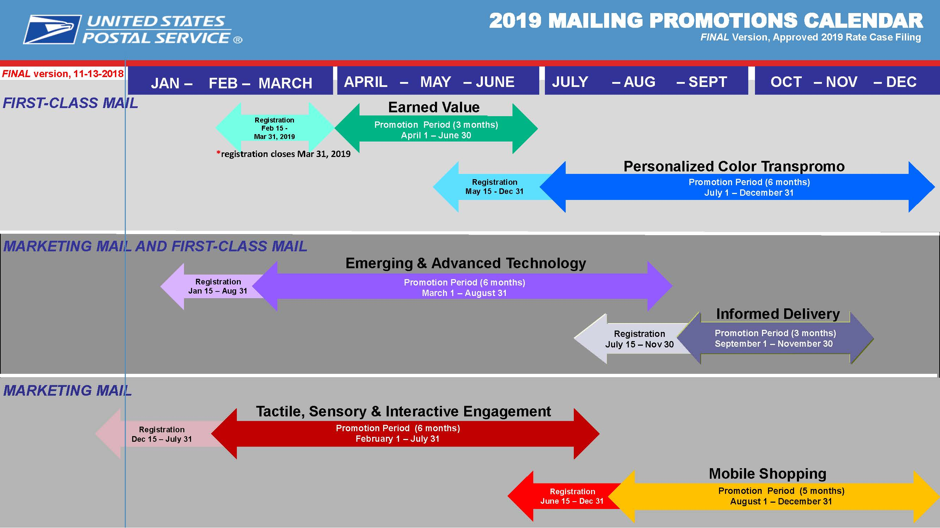

Slide 44
Product Innovation Emerging Tech
  Informed Delivery Update
    18.7 Million subscribers as of this morning
    Biggest source is COA forms
    Consider that last year - 1823 now 18,230
  Promo
    Less than 50% of mail.dat succeeded
    Here are the biggest issues.
    60% of people who have signed up for Promo have never done a campaign
    IMPORTANT - Reports will stop being on demand
  Future
    IV will be another channel to get reports
    The data delegation runs of IV will be mirrored
Notes:
Can we grab the slide needed for reasons?
Beacon Technology for use in Cremated Remains, PMOD and Registered Mail
QR Codes for packaging supplies.

Slide 45
Product Innovation Emerging Tech
  Letter shape mail volume is ok
  Flats are shrinking fast
  Earned Value Promo
    Make sure that you agree to your credits and use them by the end of the year!
    42% made the threshold
  PRODUCT Update
    Looking to add Triple packing for anything over 4 oz.
  5 Top issues the Special Service Team is working on (Shella Marano)
    - Certified mail with scan issue
    - PO Boxes - pricing
    - Premium forwarding services
    - IMBA - Qualified Business Mail
    - Testing now
    - on-boarding soon
    - Packaging Kit - for Cremated remains.
    - PUB 139

Slide 46
Product Innovation Emerging Tech
  Steve Monteith
    USPSMailJourney.com
      Built first module
      2 more modules are coming
    USPS Delivers.com
      Good stuff
      Also the NPF videos are online.
    Mail moments material will be available.
      Mail Moments is different than Household diaries

Slide 47
Payment & Acceptance Education

Slide 48
Payment & Acceptance Education
Marc McCrery
  No shipping fees - for STAMPS
  Only $1.50
  SEAMLESS!
    PROPOSED
    Feb 2021 for Full Service that have a DDU / 90% Full Service etc.
    July 1, 2021 for Full Service that bring to BMEU
    Piece weights are the bigger issue
    Working on things like undocumented
Notes:
Question: No Shipping fees for stamps only $1.50 pertains to which item?
Seamless Dina or Glen can you speak on this?

Slide 49
Payment & Acceptance Education
  Seamless Sampling
    Remove PAF
    About 42% are on seamless
    Most are letters… not a lot of flats
      Flats are affected mostly by weight variance
    Starting with Periodical Flats
      First step is to just verify if the weight is accurate
      Not change the price
      Need to establish what is acceptable error rate / range.
    Checking Permit Balance before mailing
      USPS are saying right now can’t give you a monetary amount.
      Green light / Red Light

Slide 50
Payment & Acceptance Education
  EPS
    93% of CAPS migrated
    HUGE - eVS to EPS went live this weekend
    Transaction number not showing up on Finalized Postage Statement - Fixing mapping in Jan 2020 rate release
  Plus One – Market Test
    Basically add a component to a mailing
    Both items are addressed, barcoded and DPS.
    First piece is a Letter
    Second piece is a CARD
  Promotions - TBD
  Full Service Permit Waiver Calculation Change
Notes:
I didn’t get this part of the presentation. Would someone take this slide?

Slide 51
MTAC Closing Comments
Additional Information
For additional information on topics please go to PostalPro
  Find the Industry Forum (PCC/MTAC/AIM) menu
  Look for MTAC - Meeting Presentations
Next MTAC Meeting – October 29-30, 2019
  Note: Tuesday, October 29 is open to the public, email: MTAC@usps.gov
Any issues you would like to see addressed?

Slide 52



Slide 53


For Joining Us

